Slide 1
Legal Docs Done Right: Key Provisions to Avoid Nightmares
Ferd E. Niemann IV
MHP Lawyer/Owner/Operator/Investor
Broker | CCIM | MBA | Podcaster

Slide 2
DISCLOSURE
NO attorney-client relationship exists.
For informational purposes only.
You should seek tax and legal representation from a qualified professional.
The choice of a lawyer is an important decision and should not be based solely upon advertisements.

Slide 3
1. LEGAL NAME OF SELLER AND BUYER
WHY DOES THIS MATTER IN THE PURCHASE AND SALE AGREEMENT (PSA)?
WHAT IF I DON’T KNOW SELLER’S NAME?
HOW TO FIND SELLER’S NAME
HOW TO CONFIRM SELLER’S NAME
HINT: TITLE COMPANY IS YOUR FRIEND
MAKE SURE THE SIGNATURE PAGE ALSO HAS THE CORRECT NAMES
IF I AM THE BUYER, DO I NEED TO FORM AN LLC TO SIGN A PSA?

Slide 4
2. ASSIGNMENT PROVISION
BUYER’S RIGHT TO ASSIGN IS CRUCIAL
BEST ASSIGNMENT RIGHT LANGUAGE VERSUS WHAT IS ACCEPTABLE
SINGLE PURPOSE, CONTROLLED ENTITY
WHOLESALER ASSIGNMENT RIGHTS (BROADEST)
SUBSTITUTED BUYER AND NO TRAILING LIABILITY TO ORIGINAL SIGNOR

Slide 5
3. PROPERTY DESCRIPTION
SURVEYOR LEGAL DESCRIPTION (BEST!)
COUNTY RECORDS SEARCH
PROPERTY TAX LEGAL DESCRIPTION
GOOGLE MAPS PICTURE IDENTIFYING THE LAND
DO NOT LEAVE BLANK
IF THE PROPERTY IS NOT IDENTIFIED… IS THERE EVEN A CONTRACT?
PERSONAL PROPERTY / MOBILE HOMES
YEAR / MAKE / MODEL / VIN (and copies of titles)
EQUIPMENT / INTANGIBLES

Slide 6
4. PURCHASE PRICE AND EARNEST MONEY DEPOSIT
PURCHASE PRICE IS PRETTY EASY, HOWEVER…
SELLER-FINANCING?
PROMISSORY NOTE / MORTGAGE / PERSONAL GUARANTY
EARNEST MONEY:
WHEN IS IT DUE TO TITLE COMPANY?
NEVER PAY TO SELLER DIRECTLY
HOW TO PAY TO ASSIGNOR (IF AT ALL) ON A WHOLESALE DEAL
APPLICABLE TO PURCHASE PRICE
TIMING OF EMD NON-REFUNDABILITY

Slide 7
5. RIGHT OF ENTRY
YOU NEED PERMISSION TO ENTRY THE PREMISES TO CONDUCT DUE DILIGENCE
IT IS STANDARD TO MAKE SELLER WHOLE FOR DAMAGES YOU (OR 3RD PARTY AGENTS) CAUSE TO THE PROPERTY
BORING, DRILLING, SUBSURFACE, ETC. – REQUIRE SELLER APPROVAL?

Slide 8
6. TITLE COMMITMENT, TITLE OBJECTIONS, AND TITLE POLICY
TITLE COMMITMENT (OR PRELIMINARY TITLE REPORT) VS. PRO FORMA
STANDARD VS. EXTENDED COVERAGE
EXCEPTIONS / ENDORSEMENTS
POST-CLOSING TITLE POLICY
ALTA FORM OWNER’S POLICY
TITLE OBJECTION RIGHTS (AND WHEN TO OBJECT)
REMEDY IF TITLE IS NOT ACCEPTABLE OR UNCURABLE BY SELLER
EMD RETURN
REIMBURSEMENT OF OUT-OF-POCKET EXPENSES AND DUE DILIGENCE COSTS
TYPES OF SURVEY, WHO PAYS, AND HOW/WHEN IT IMPACTS THE CLOCK

Slide 9
7. RISK OF LOSS AND CONDEMNATION
MAKE SURE YOUR PSA GIVES YOU (BUYER) THE RIGHT TO TERMINATE THE CONTRACT IF LOSS OCCURS OR THE PROPERTY IS CONDEMNED PRIOR TO CLOSING
SELLER BEARS THE RISK UP AND UNTIL CLOSING
INSURANCE OR EMINENT DOMAIN PROCEEDS

Slide 10
8. DUE DILIGENCE PERIOD
WHEN DOES THE “SHOT CLOCK” START?
EFFECTIVE DATE (WHAT IF SELLER DOESN’T DELIVER? DEFAULT)
RECEIPT OF DD MATERIALS, TITLE COMMITMENT, AND SURVEY?
WHEN DOES IT END?
DATE AND TIME – BE SPECIFIC
ABSOLUTE RIGHT FOR BUYER TO TERMINATE PRIOR TO EXPIRATION
HOW? MAKE SURE NOTICE SECTION OF PSA PROVIDES FOR EMAIL DELIVERY OF TERMINATION NOTICES
EARNEST MONEY RETURN IF PSA IS TERMINATED
AUTO LIVE VS AUTO HARD
MAKE IT CLEAR FOR THE TITLE COMPANY (BE VERY CLEAR)
USE A TITLE COMPANY YOU CAN PREDICT – “SOLE AND UNILATERAL RIGHT TO TERMINATE”
EXTENSION PERIOD (AND FEE) / HOW DO YOU ELECT THIS? APPLICABLE?

Slide 11
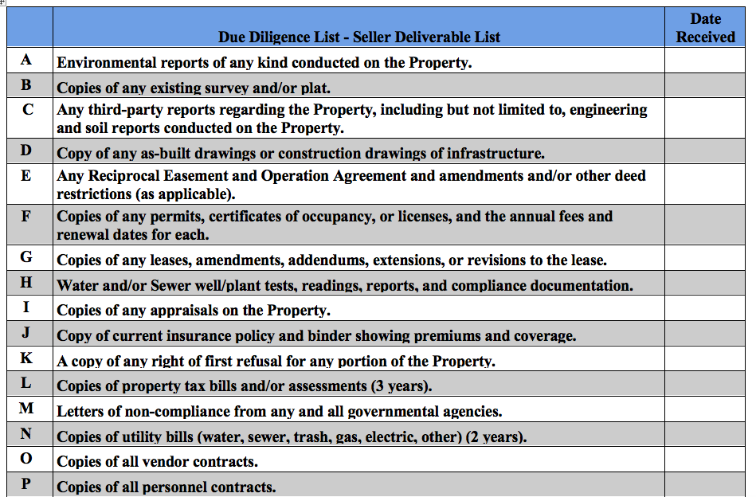
9. SELLER DELIVERABLES (EXHIBIT TO PSA )

Slide 12
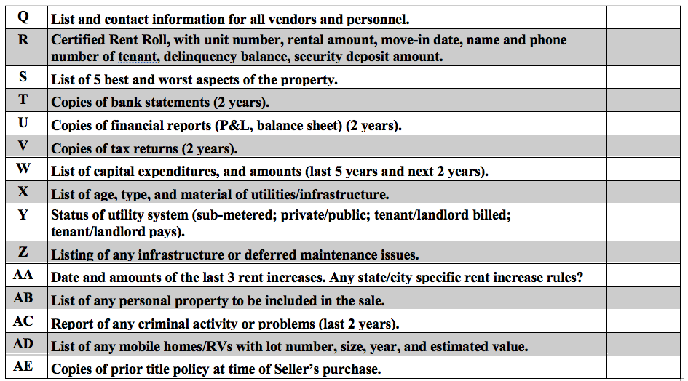
SELLER DELIVERABLES (CONT.)

Slide 13
10. SELLER COVENANTS (PROMISES)
TERMINATE ALL PERSONNEL, EMPLOYMENT, VENDOR, AND SERVICE CONTRACTS PRIOR TO CLOSING
INTERVIEW MANAGEMENT PRIOR TO CLOSING BUT NOT BE OBLIGATED TO HIRE A BAD MANAGER
NO UNEMPLOYMENT CLAIMS (EXAMPLE)
SECURITY CAMERA CONTRACTS (EXAMPLE)
TRASH, WATER, BILLING, MANAGEMENT (EXAMPLE)
CONTINUE TO OPERATE THE PROPERTY UP TO CLOSING
MAINTENANCE, COLLECTIONS, EVICTIONS
CONTINUED COMPLIANCE WITH RULES AND REGULATIONS

Slide 14
11. REPRESENTATIONS AND WARRANTIES
SELLER AUTHORITY TO SIGN PSA AND SELL PROPERTY
NO OPTIONS OR OTHER RENTAL ARRANGEMENTS OR RIGHTS OF FIRST REFUSAL IN PLACE (OTHER THAN MH TENANT LEASES)
NOTE: CERTAIN STATES HAVE STATUTORY, TENANT ROFR RIGHTS AND NOTICE OBLIGATIONS (COLORADO, FOR EXAMPLE)
PROPERTY HAS DIRECT VEHICULAR AND PEDESTRIAN ACCESS
SELLER NOT AWARE OF ANY LEGAL ACTIONS OR PROCEEDINGS AGAINST THE PROPERTY / COMPLIANCE WITH RULES AND REGULATIONS
NO THREATENED CONDEMNATION
ALL LICENSES NEEDED FOR OPERATION ARE IN PLACE
NO SPECIAL TAXES OR ASSESSMENTS
NO HAZARDOUS WASTE OR DANGEROUS CONDITIONS
PROPERTY NOT SUBJECT TO RENT CONTROL LAWS, RENT STABILIZATION LAWS, ETC.
PROPERTY SHALL NOT GO DOWN IN CONDITION OR VALUE (MATERIAL?)
MAKE SELLER SAY YES, NO, OR N/A

Slide 15
12. CONDITIONS PRECEDENT TO CLOSING
THESE ARE USUALLY STILL VALID EVEN AFTER DUE DILIGENCE PERIOD (AKA “INSPECTION PERIOD”) HAS PASSED AND GIVES THE BUYER AN OUT PRIOR TO CLOSING (PLUS EMD RETURN AND POSSIBLY DAMAGES)
FINANCING CONTINGENCY
INSURANCE CONTINGENCY
SATISFACTORY REVIEW OF ENVIRONMENTAL/ SURVEY/APPRAISAL
THESE ARE HEAVILY NEGOTIATED ALONG WITH SELLER REPS

Slide 16
13. CLOSING PRORATIONS AND CLOSING COSTS
TAXES
RENTS (INCLUDING BACK RENT)
TITLE POLICY
TRANSFER OR GRANTOR FEES
DOCUMENT STAMPS
ESCROW FEES
SURVEY
ENVIRONMENTAL REPORTS
AVOID “LOCAL CUSTOM”
POST-CLOSING ESCROW HOLDBACK AGREEMENT?

Slide 17
14. CLOSING
BEST TO TIME BASED ON “X” DAYS AFTER EXPIRATION OF DD PERIOD
NOTE: WHEN DID THE “SHOT CLOCK” START?
CLOSING DELIVERABLES
DEED
ASSIGNMENT OF LEASES
BILL OF SALE
NOTE / MORTGAGE
ASSIGNMENT OF NOTES (MOBILE HOMES / SELLER-FINANCED)
TENANT NOTICES
FIRPTA, ENTITY DOCS, ETC.
KEYS / CODES / ETC.
CLOSING FUNDS (BUYER)
ANYTHING ELSE TITLE COMPANY REQUIRES
1031 DOCS
BEST PRACTICE INCLUDES A CLOSING INSTRUCTION LETTER

Slide 18
15. SELLER DEFAULT PROVISION
SELLER DEFAULT
SPECIFIC PERFORMANCE
PLUS DAMAGES (AT LAW AND EQUITY), LOST PROFITS, LOST BUSINESS OPPORTUNITIES, CONSEQUENTIAL DAMAGES, OR…
TERMINATE THE CONTRACT AND EARNEST MONEY AND EXTENSION FEES RETURNED, PLUS…
REPORTS, DD COSTS, LOAN APPLICATION FEES REIMBURSED
IF NOT, LIEN PROPERTY
NOTICE AND CURE PERIOD?
GO FOR MORE THAN ONE DEFAULT OPTION/REMEDY

Slide 19
16. BUYER DEFAULT PROVISION
SOLE REMEDY… RETAIN THE EARNEST MONEY AS LIQUIDATED DAMAGES
BUYERS: DO NOT AGREE TO SPECIFIC PERFORMANCE
BUYERS: MINIMIZE REPS (AND HAVE SELLER HELP WITH DD)
NOTICE AND CURE PERIOD?
AT LEAST ONE BUSINESS DAY
FEDS CAN HOLD UP A WIRE ON THE DAY OF CLOSING
UPS/FED EX IS SOMETIMES LATE

Slide 20
17. NOTICE PROVISION
EMAIL DELIVERY SHOULD BE FINE
HAVE MORE THAN ONE PERSON/ENTITY TO BE NOTICED
ARE EMAILS PLUS ANOTHER FORM OF COMMUNICATION REQUIRED?
NO P.O. BOXES IN THE EVENT OF LITIGATION
OFTEN MISSED BY PARTIES, WILL RESULT IN A LATER PSA AMENDMENT
MAKE SURE IF NO EMAIL DELIVERY, TERMINATION NOTICES ARE SENT OUT TIMELY
ALWAYS INCLUDE CONTACT INFORMATION

Slide 21
18. SURVIVABILITY
SELLER REPS AND WARRANTIES “SURVIVE CLOSING”
THIS HELPS KEEP SELLER HONEST AND MAY PROVIDE POST-CLOSING RELIEF
TIMELINE FOR SURVIVAL IS NEGOTIABLE

Slide 22
19. BROKER PROVISION
CLARIFY WHETHER BUYER/SELLER IS PAYING BROKER/S
DISCLOSURE REQUIRED?
WAIVERS (PROTECTS BROKERS AND YOU!)
INDEMNIFICATION OF OTHER PARTY IF A BROKER “POPS UP” AFTER CLOSING AND DEMANDS PAYMENT
MANY BROKERS HAVE STANDARD LANGUAGE THEY WANT PUT IN – USUALLY OK BUT DON’T LET BROKERS GET FEES IN EVENT OF DEFAULT

Slide 23
20. SECTION 1031 EXCHANGES
STANDARD BUT INCLUDE TO AVOID ADVERSARIAL DEALINGS
ALLOW FOR TIC / DROP & SWAP PSA ASSIGNMENTS IF NOT ALREADY ADDRESSED IN ASSIGNMENT SECTION
MAKE SURE ALL PARTIES (ESPECIALLY TITLE) ARE AWARE OF A 1031 EXCHANGE WELL IN TIME OF CLOSING
GET QUALIFIED INTERMEDIARY INVOLVED ASAP
SOMETIMES ADDS COMPLICATIONS (AND COSTS)

Slide 24
21. MISCELLANEOUS
COVID / FORCE MAJEURE DELAYS
FIRPTA / ANTI-TERRORISN
ENTIRE AGREEMENT
BINDING EFFECT
GOVERNING LAW
CONFIDENTIALITY
INCORPORATE EXHIBITS
NO BACK UP OFFERS ALLOWED BY SELLER
TIME COMPUTATION (MAKE SURE THIS IS CLEAR – PERFORMANCE DATE SHOULD GET EXTENDED IF FALLS ON A HOLIDAY OR WEEKEND
WAIVER OF JURY TRIAL
OFFER NOT VALID AFTER “X” DATE

Slide 25
22. EXHIBITS
LEGAL DESCRIPTION
PURCHASE PRICE ALLOCATION
PERSONAL PROPERTY (MOBILE HOMES / VIN / LOT #’S)
SELLER-FINANCED NOTES ON MOBILE HOMES
LOT NO. / VIN / BORROWER NAME / BALANCE
SELLER DELIVERABLES
RENT ROLL
FORMS TO SIGN AT CLOSING
BILL OF SALE
ASSIGNMENT OF LEASES
DEED
NOTE / MORTGAGE / GUARANTY
ESCROW HOLDBACK AGREEMENT

Slide 26
OTHER IMPORTANT DOCS
LENDER DOCS (DEED, NOTE, BUSINESS LOAN AGREEMENT, GUARANTY)
CLOSING DOCS
PRIVATE PLACEMENT MEMORANDUM
OPERATING AGREEMENT
ASSET MANAGEMENT AGREEMENT
PROPERTY MANAGEMENT AGREEMENT
TIC AGREEMENT
ZONING LETTER (PART OF DD)
LEASES (STATE-SPECIFIC) AND SALES FORMS
LICENSES/PERMITS/DEALER FORMS/
EMPLOYMENT HANDBOOK (FHA, JOB DESCRIPTIONS, ETC.)
OPERATIONAL POLICIES

Slide 27
ANY QUESTIONS?!

